Slide 1
Advanced Artificial Intelligence
Week # 9
Dr. Qurat Ul Ain
Assistant Professor Dept. of AI & DS
FAST NUCES, Islamabad
Email: quratul.ain@isb.nu.edu.pk

Slide 2
Outline
Unsupervised learning
Clustering
Clustering Methods
Evaluation of Clustering
K-means Clustering
K-means Clustering Algorithm
Why K-means Converges
K-means – Examples
Evaluation of K-means Clustering
Limitation of K-means Clustering
Summary

Slide 3
Unsupervised Learning
Supervised learning algorithms have a clear goal: produce desired outputs for given inputs.
You are given {(x ^{(i )}, t^{(i )})} during training (inputs and targets)
Goal of unsupervised learning algorithms (no explicit feedback whether outputs of system are correct) less clear.
You are given the inputs {x ^{(i )}} during training, labels are unknown.
Tasks to consider:
Reduce dimensionality
Find clusters
Model data density
Find hidden causes
Key utility
Compress data
Detect outliers
Facilitate other learning
4 / 20

Slide 4

Unsupervised Learning
The learning algorithm would receive unlabeled raw data to train a model and to find patterns in the data
Training Data
All unlabeled data
Structured data, Labeled data, Clustering
Model

Slide 5
Major Types
Primary problems, approaches in unsupervised learning fall into three classes:
Dimensionality reduction: represent each input case using a small number of variables (e.g., principal components analysis, factor analysis, independent components analysis)
Clustering: represent each input case using a prototype example (e.g., k-means, mixture models)
Density estimation: estimating the probability distribution over the data space
5 / 20
Notes:
In probability and statistics, density estimation is the construction of an estimate, based on observed data, of an unobservable underlying probability density function. The unobservable density function is thought of as the density according to which a large population is distributed; the data are usually thought of as a random sample from that population.

Slide 6
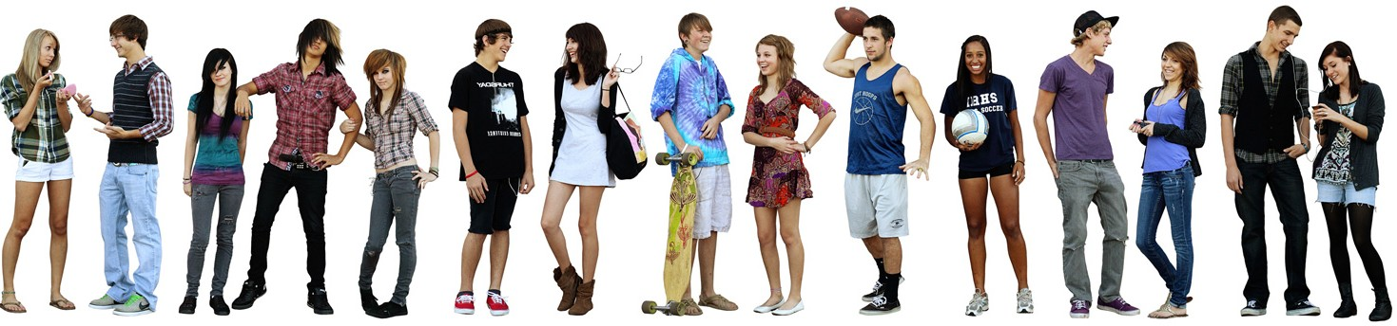
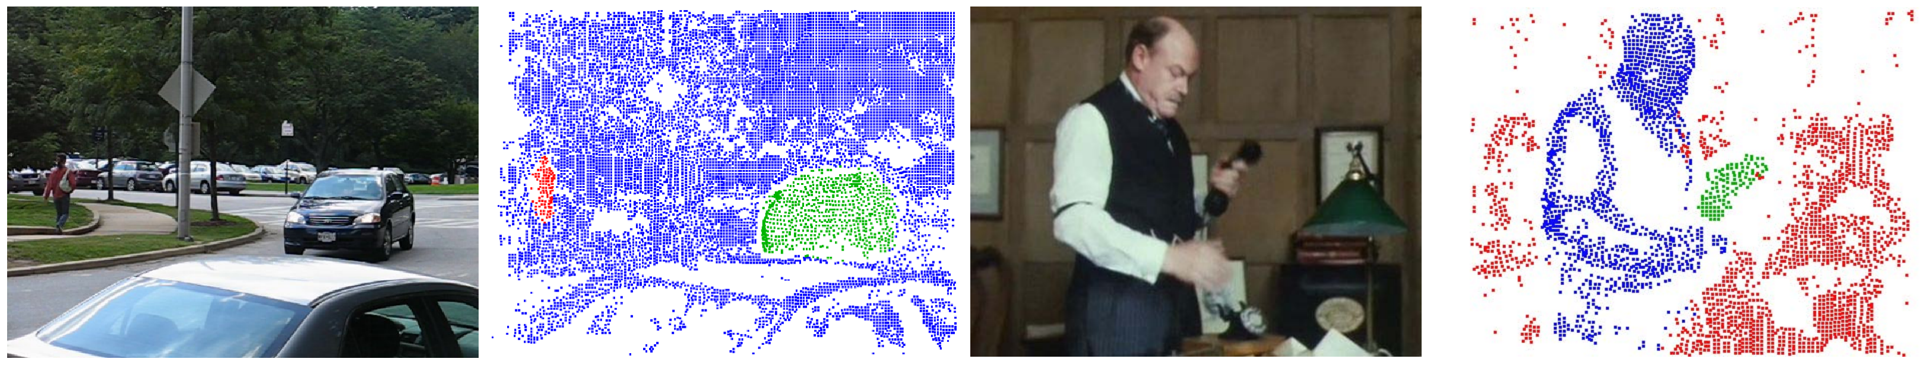
Motivating Examples
Determine groups of people in image above
based on clothing styles
gender, age, etc
Determine moving objects in videos
3 / 20

Slide 7
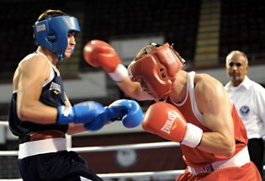

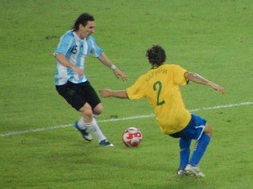
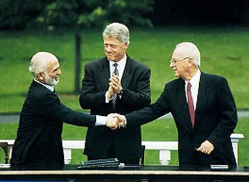
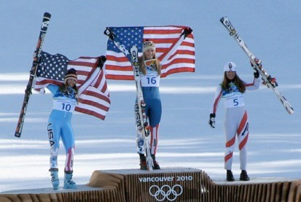
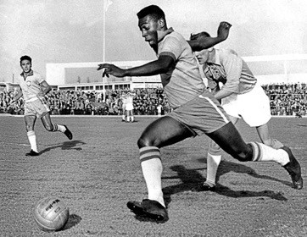
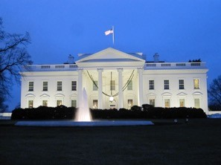
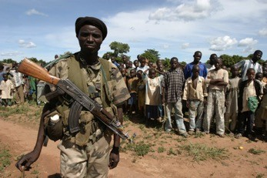
Structure Documents By Topic
Discover groups (clusters) of related articles
SPORTS
WORLD NEWS

Slide 8




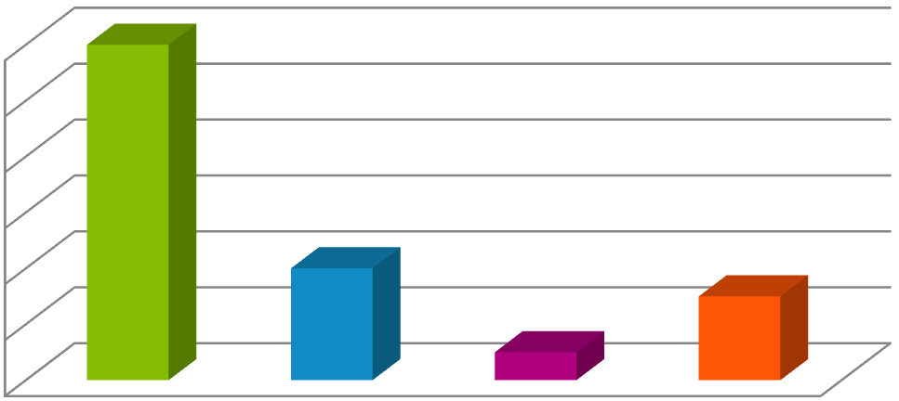
Why Might Clustering Be Useful?
I don’t just like sports!
0.6
0.5
0.4
0.3
0.2
0.1
0
Sports
Entertainment
Science
World News
8

Slide 9
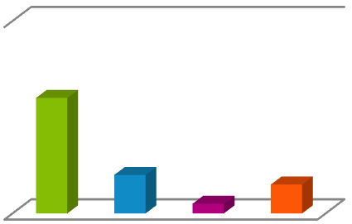
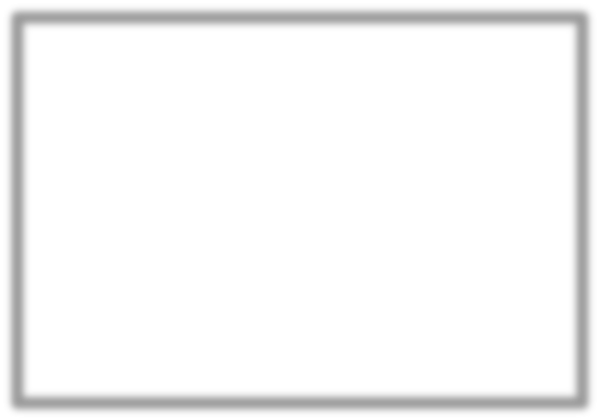

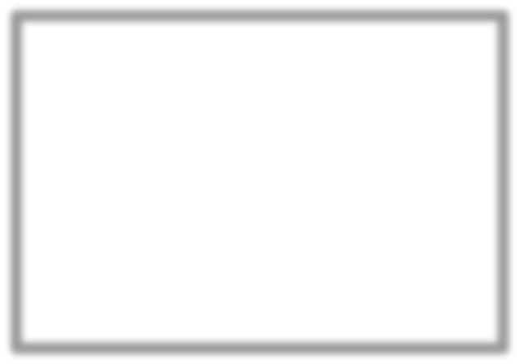






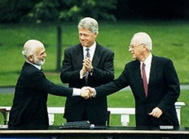



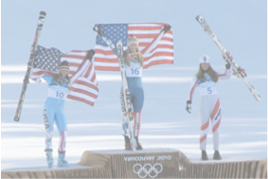


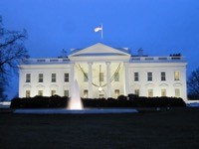
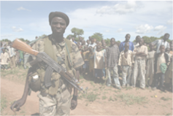

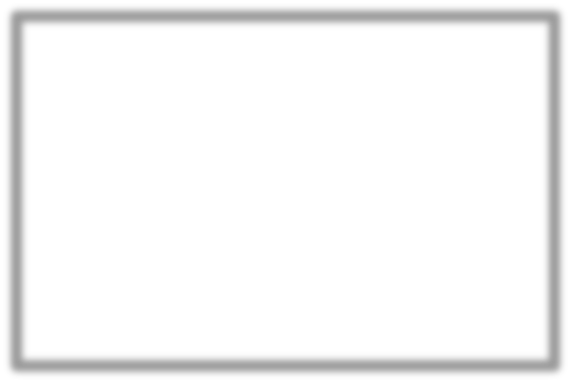
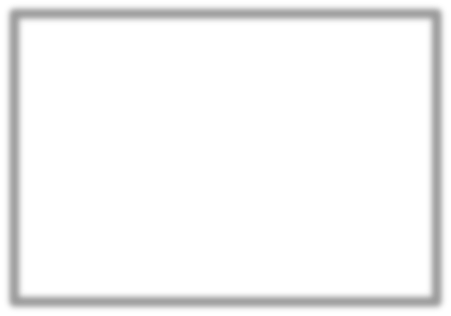
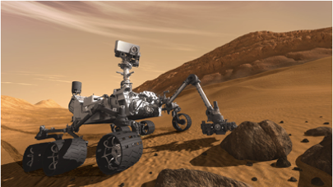
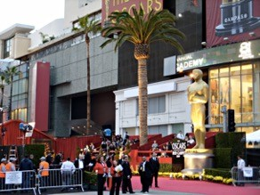


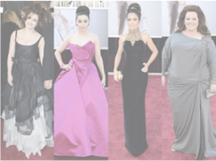
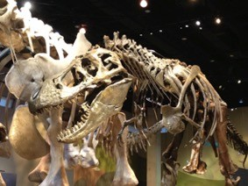
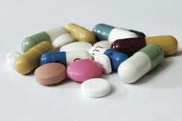



Learn User Preferences
Set of clustered documents read by user
Cluster 1
Cluster 2
Use feedback to learn user preferences over topics
Cluster 3
Cluster 4

Slide 10
Clustering
Data WITHOUT classes or labels
Deals with finding a structure in a collection of unlabeled data.
The process of organizing objects into groups whose members are similar in some way.
A cluster is therefore a collection of objects which are “similar” between them and are “dissimilar” to the objects belonging to other clusters.

Slide 11
Applications Of Clustering
Marketing: It can be used to characterize & discover customer segments for marketing purposes.
Biology: It can be used for classification among different species of plants and animals.
Libraries: It is used in clustering different books on the basis of topics and information.
Insurance: It is used to acknowledge the customers, their policies and identifying the frauds.
City Planning: It is used to make groups of houses and to study their values based on their geographical locations and other factors present.
Earthquake studies: By learning the earthquake-affected areas we can determine the dangerous zones.

Slide 12
Clustering Methods/Algorithms
In clustering algorithms, we usually optimize the following for a given
number of clusters.
Tightness, spread, cohesion of clusters
Separability of clusters, distance between the centers
Ideally, we require clustering algorithms to be
scalable (in terms of both time and space)
able to deal with different data types and noise/outliers
insensitive to order of input records
interpretable and usable

Slide 13
Clustering Methods
Density-Based Methods: These methods consider the clusters as the dense region having some similarities and differences from the lower dense region of the space.
These methods have good accuracy and the ability to merge two clusters.
Example DBSCAN (Density-Based Spatial Clustering of Applications with Noise), OPTICS (Ordering Points to Identify Clustering Structure), etc.
Hierarchical Based Methods: The clusters formed in this method form a tree-type structure based on the hierarchy.
New clusters are formed using the previously formed one.

Slide 14
Clustering Methods
Hierarchical Based Methods:
These find successive clusters using previously established clusters.
1. Agglomerative ("bottom-up"): Agglomerative algorithms begin with each element as a separate cluster and merge them into successively larger clusters.
2. Divisive ("top-down"): Divisive algorithms begin with the whole set and proceed to divide it into successively into smaller clusters.
Hierarchical

Slide 15
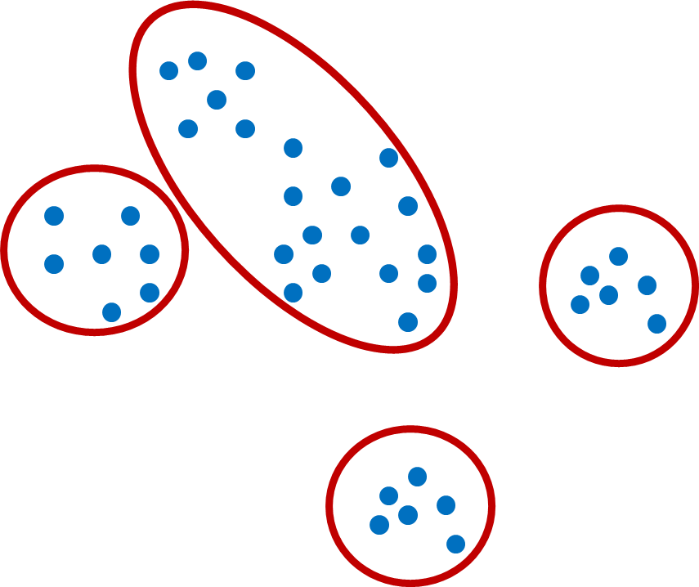
Clustering Methods
Partitioning Methods: These methods partition the objects into k clusters and each partition forms one cluster.
Divides data points into non-overlapping subsets (clusters) such that each data point is in exactly one subset.
This method is used to optimize an objective criterion similarity function such as when the distance is a major parameter example K-means, CLARANS (Clustering Large Applications based upon Randomized Search), etc.
Construct a partition of a data set to produce several clusters – At once
The process is repeated iteratively – Termination condition
Examples
K-means clustering
Fuzzy c-means clustering
Partitional

Slide 16
Grid-based Methods
In this method, the data space is formulated into a finite number of cells that form a grid-like structure.
All the clustering operations done on these grids are fast and independent of the number of data objects example STING (Statistical Information Grid), wave cluster, CLIQUE (CLustering In Quest), etc.

Slide 17

Clustering
(Dis)similarity Using Distance Metric:
Non-negativity Symmetry
Self-Similarity Triangular Inequality
We can use: Minkowski, Euclidean distance, Manhattan distance, Chebyshev distance, cosine distance
For categorical variables, we use Hamming distance

Slide 18
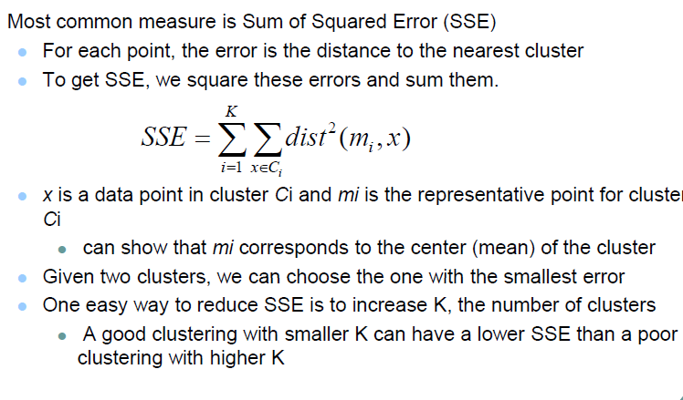
Evaluating K-means Clusters
Notes:
How to determine k using the Elbow Method?
Calculate the Within-Cluster-Sum of Squared Errors (WSS) for different values of k, and choose the k for which WSS becomes first starts to diminish.

Slide 19
Evaluation Of Clustering
Unlike supervised learning problems, the evaluation of quality of a clustering is a hard problem and is mostly subjective as the information about correct clusters is unknown.
Evaluation criteria:
Using Internal Data:
Use the unlabeled data for evaluation of the clustering algorithm.
Using External Data:
Use labeled data (supervised learning) to evaluate the performance of different clustering algorithms.

Slide 20



Evaluation Of Clustering Using Internal Data
Inter-cluster separability
measure of the isolation of the cluster
E.g., measured as the distance between the centroids of the clusters
Intra-cluster cohesion
measure of the compactness of the cluster
E.g., measured by the sum of squared error that quantifies the spread of the points around the centroid.

Slide 21
Evaluation Of Clustering Using External (Labeled) Data
Use labeled data to carry out clustering and measure the extent to
which the external class labels match the cluster labels.
Idea: Evaluation of clustering performance using the labeled data gives us some confidence about the performance of the algorithm.
This evaluation method is referred to as evaluation based on external data.
Assuming each class as a cluster, we use classification evaluation metrics after clustering:
Confusion matrix
Precision, recall, F1-score
Purity and Entropy

Slide 22
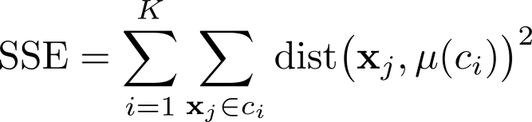
Evaluation Of K-means Clustering

Slide 23

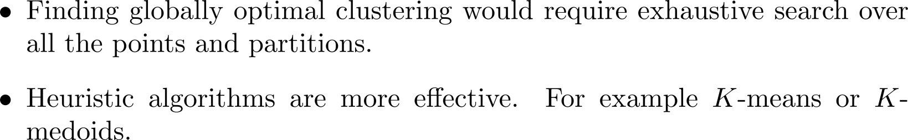
Partitional Clustering

Slide 24
K-means Clustering
It is the simplest unsupervised learning algorithm that solves clustering problem.
K-means algorithm partitions n observations into k clusters where each observation belongs to the cluster with the nearest mean serving as a prototype of the cluster.
We are given a data set of items, with certain features, and values for these features (like a vector).
The task is to categorize those items into groups.
To achieve this, we will use the k-Means algorithm; an unsupervised learning algorithm.

Slide 25
K-means Clustering
(It will help if you think of items as points in an n-dimensional space). The algorithm will categorize the items into k groups of similarity. To calculate that similarity, we will use the Euclidean distance as measurement.
The algorithm works as follows:
First, we initialize k points, called means, randomly.
We categorize each item to its closest mean and we update the mean’s coordinates, which are the averages of the items categorized in that mean so far.
We repeat the process for a given number of iterations and at the end, we have our clusters.

Slide 26
K-means Clustering
The “points” mentioned above are called means because they hold the mean values of the items categorized in them.
To initialize these means, we have a lot of options.
An intuitive method is to initialize the means at random items in the data set.
Another method is to initialize the means at random values between the boundaries of the data set (if for a feature x the items have values in [0,3], we will initialize the means with values for x at [0,3]). The above algorithm in pseudocode:

Slide 27
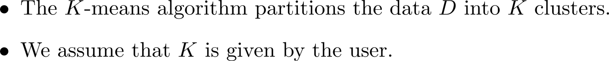
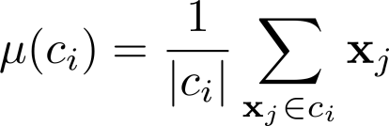
K-means Clustering

Slide 28
K-means Clustering Algorithm
Chose the number (K) of clusters and randomly select the centroids of each cluster.
For each data point:
Calculate the distance from the data point to each cluster.
Assign the data point to the closest cluster.
Re-compute the centroid of each cluster.
Repeat steps 2 and 3 until there is no further change in the assignment of data points (or in the centroids).

Slide 29


K-means Clustering Algorithm
Complexity

Slide 30
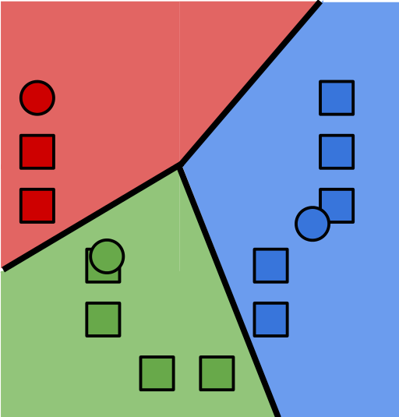
K-means Clustering Algorithm
Initialize cluster centers
Assign observations to closest cluster center
Revise cluster centers as mean of assigned observations
Repeat 1.+2. until convergence

Slide 31
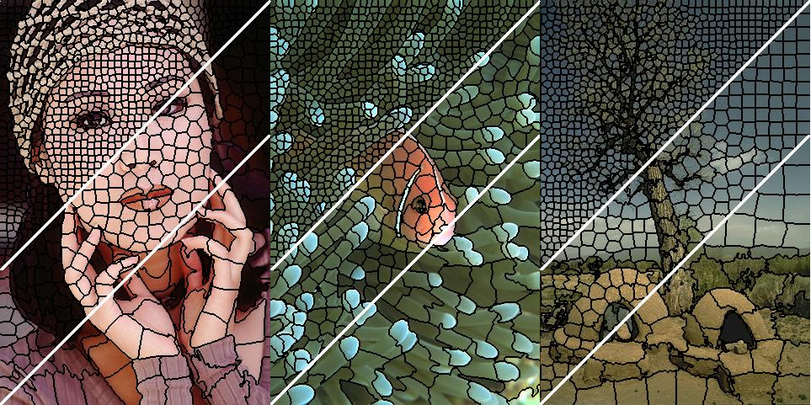
K-means For Image Segmentation
How would you modify k-means to get super pixels?

Slide 32
Questions About K-means
Why does update set m_{k} to mean of assigned points?
Where does distance d come from?
What if we used a different distance measure? How can we choose best distance?
How to choose K ?
How can we choose between alternative clusterings? Will it converge?
Hard cases – unequal spreads, non-circular spreads, in-between points
14 / 20

Slide 33
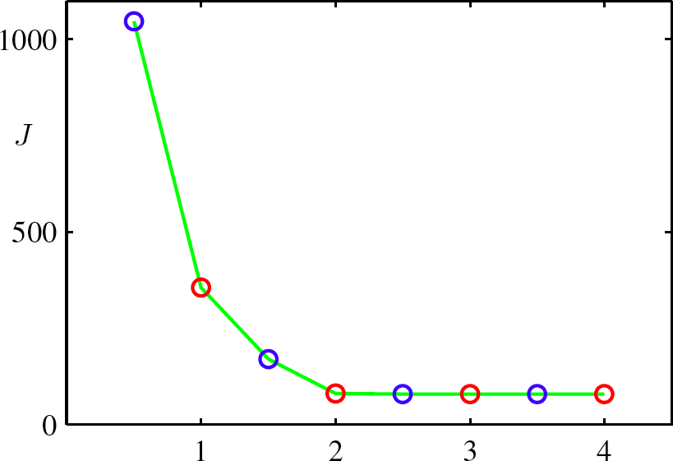
Why K-means Converges
Whenever an assignment is changed, the sum squared distances J of data points from their assigned cluster centers is reduced.
Whenever a cluster center is moved, J is reduced.
Test for convergence: If the assignments do not change in the assignment step, we have converged (to at least a local minimum).
K-means cost function after each E step (blue) and M step (red). The algorithm has converged after the third M step
15 / 20

Slide 34
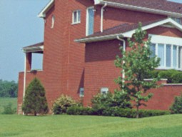
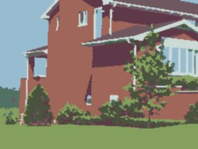
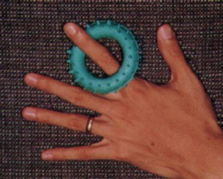

K-means – Example
Data Points – RGB Values of pixels
Can be used for Image Segmentation

Slide 35
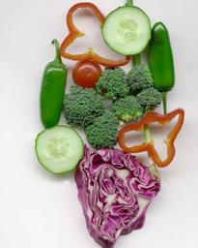
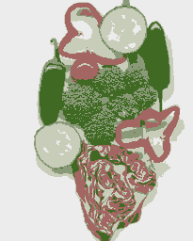
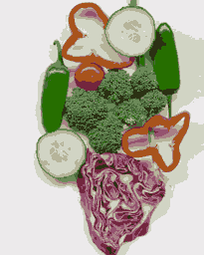
K-means – Example
Original
K=5
K=11

Slide 36
K-means – Example
 | Height | Weight
1 | 185 | 72
2 | 170 | 56
3 | 168 | 60
4 | 179 | 68
5 | 182 | 72
6 | 188 | 77
7 | 180 | 71
8 | 180 | 70
9 | 183 | 84
10 | 180 | 88
11 | 180 | 67
12 | 177 | 76
Euclidean Distance
√(X₀ –X_{c})² + (Y₀ –Y_{c})²
ED for 3
K1= √(168 –185)² + (60-72)² =20.80
K2= √(168 –170)² + (60-56)² =4.48
New centroid for K2
(170+168)/2, (60+56)/2 = (169, 58)
K1
185, 72
K2
170, 56
K1
185, 72
K2
169, 58

Slide 37
K-means – Example
ED for 4
K1= √(179 –185)² + (68-72)² = 6.32
K2= √(179 –169)² + (68-58)² = 14.14
K1 → {1, 4, 5, 6, 7, 8, 9, 10, 11, 12}
K2→ {2, 3}

Slide 38
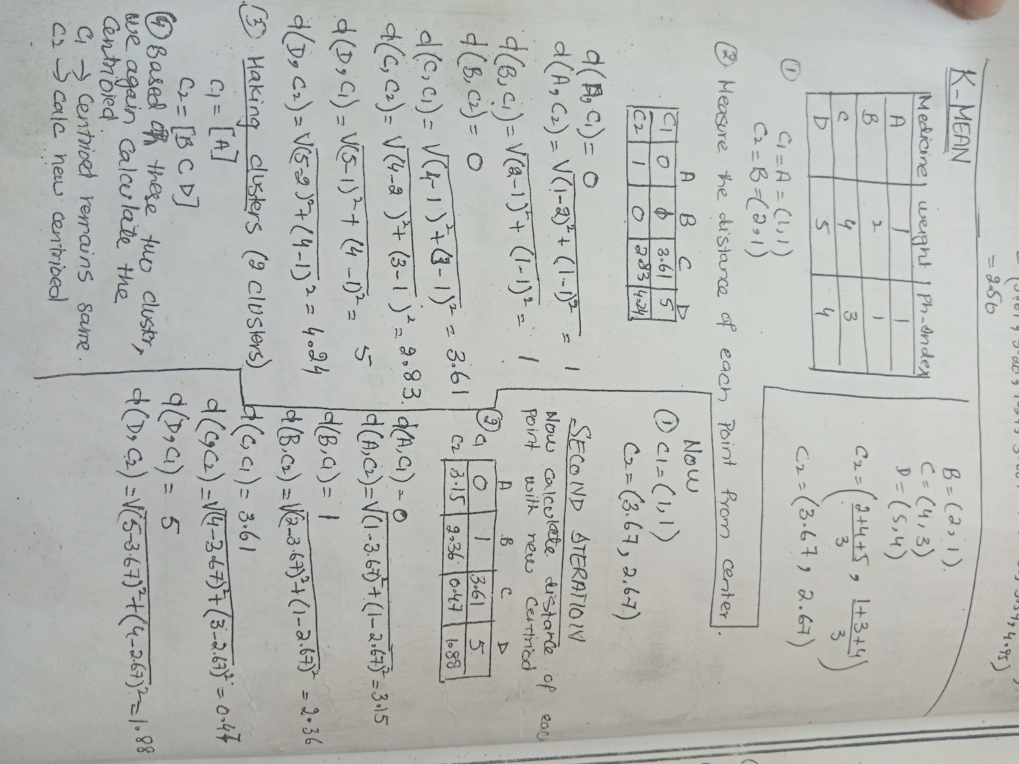
K-means – Example

Slide 39
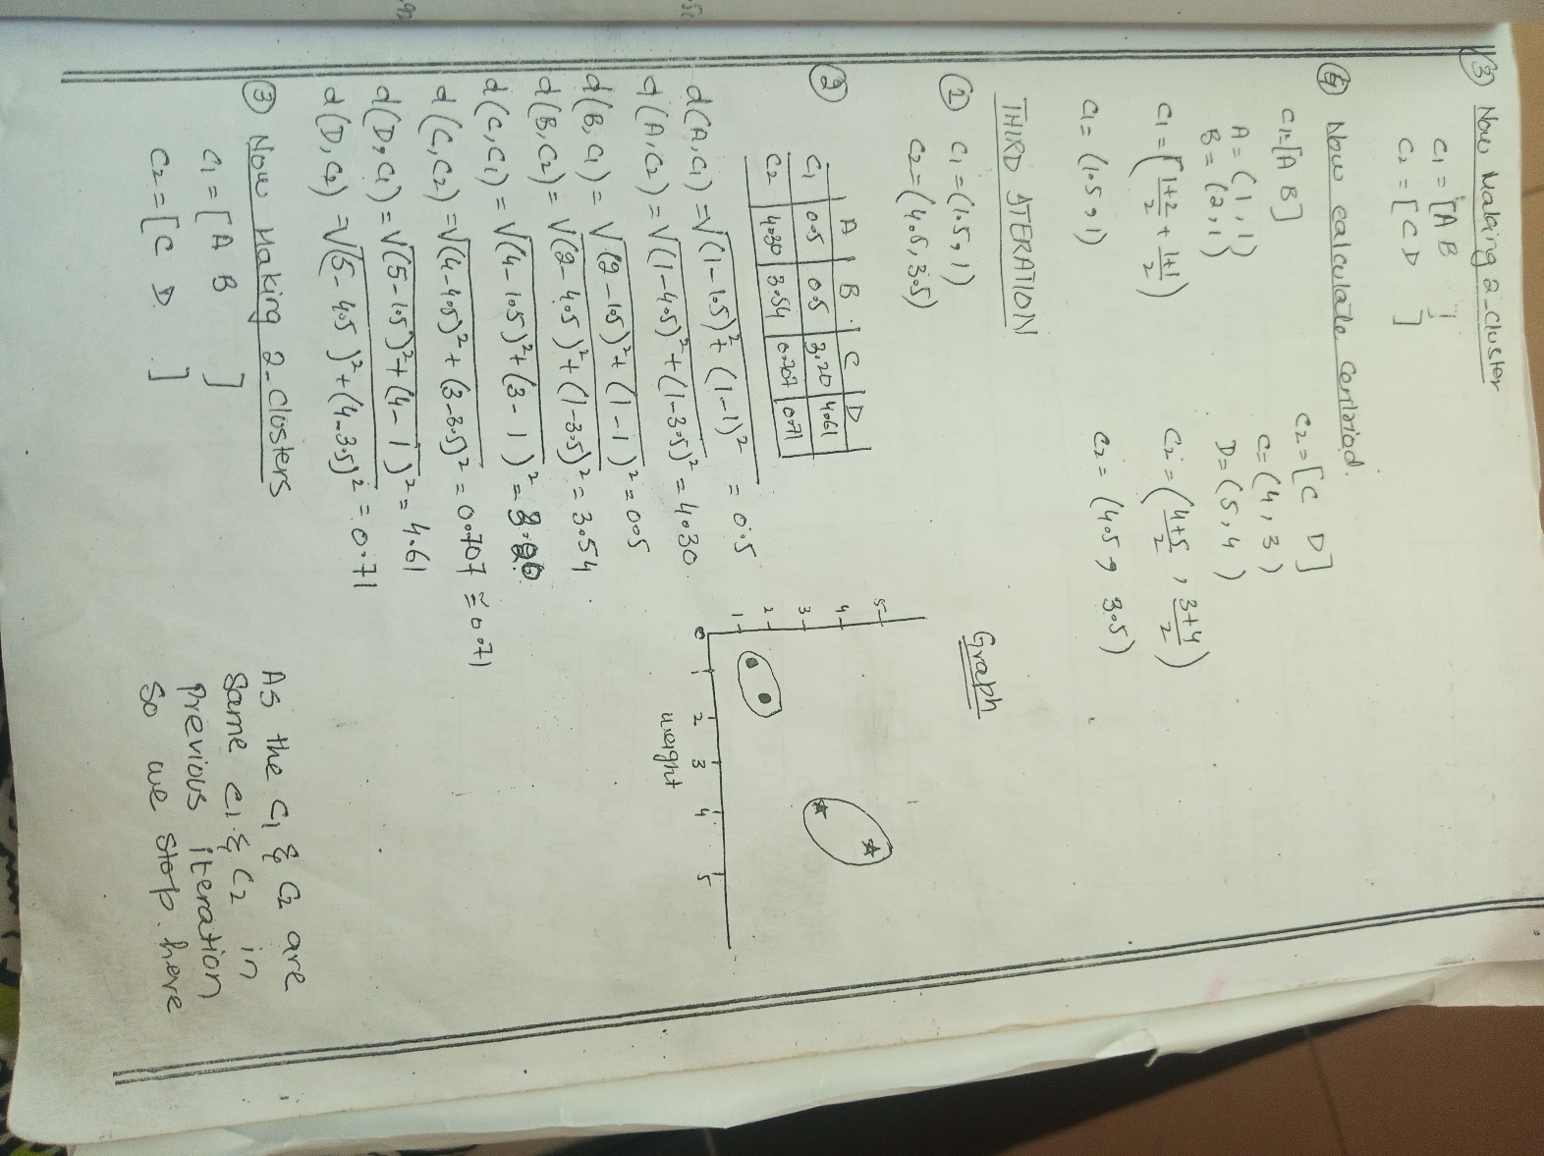
K-means – Example

Slide 40
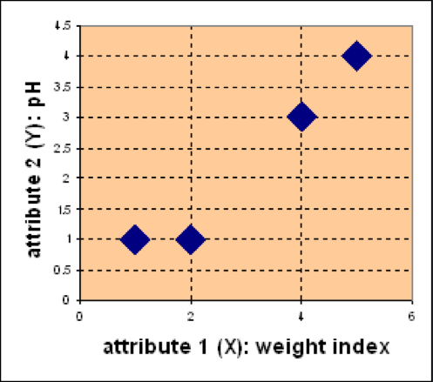
K-means – Example
Suppose we have 4 medicines and each has two attributes (pH and weight index). Our goal is to group these objects into K=2 clusters of medicine
D
Medicine | Weight | pH-Index
A | 1 | 1
B | 2 | 1
C | 4 | 3
D | 5 | 4
C
A
B

Slide 41
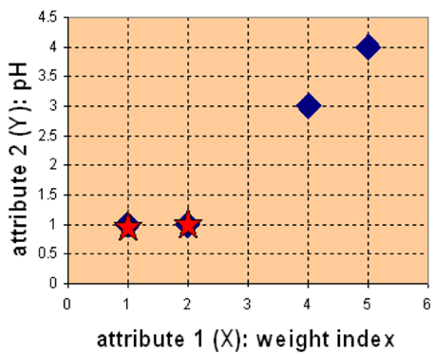
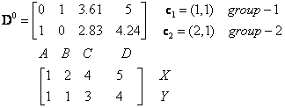
K-means – Example
Compute the distance between all samples and K centroids

Slide 42
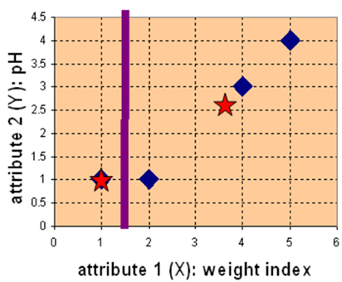

K-means – Example
Assign the sample to its closest cluster
An elements in a row of the Group matrix below is 1 if and only if the object is assigned to that group

Slide 43
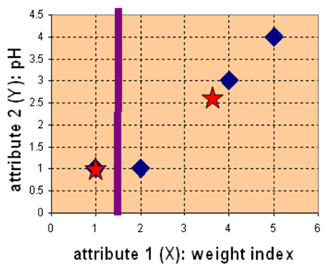
K-means – Example
Re-calculate the K-centroids
Knowing the members of each
cluster, now we compute the new
centroid of each group based on
these new memberships.

Slide 44
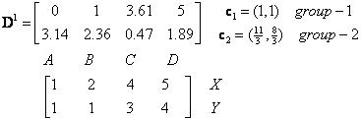
K-means – Example
Repeat the above steps
Compute the distance of all objects to the new centroids

Slide 45
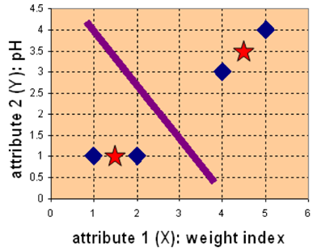

K-means – Example
Assign the membership to objects

Slide 46
K-means – Example
Knowing the members of each
cluster, now we compute the new
centroid of each group based on
these new memberships.

Slide 47
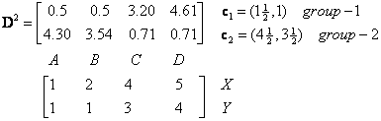
K-means – Example

Slide 48

K-means – Example

Slide 49
K-means – Example
We obtain result that G²=G¹. Comparing the grouping of last iteration and this iteration reveals that the objects do not move group anymore.
Thus, the computation of the k-mean clustering has reached its stability and no more iterations are needed..

Slide 50
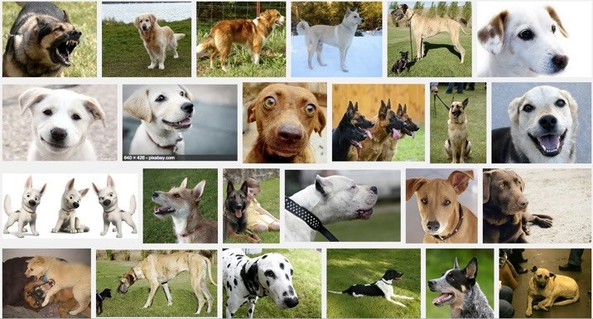




Clustering Images
For search, group as:
Ocean
Pink flower
Dog
Sunset
Clouds
- …

Slide 51
Feature Scaling in K-Means
K-Means typically needs to have some form of normalization done on the datasets to work properly since it is sensitive to both the mean and variance of the datasets.
For performing feature scaling, generally, StandardScaler is recommended, but depending on the specific use cases, other techniques might be more suitable as well.
For Example, let’s have 2 variables, named age and salary where age is in the range of 20 to 60 and salary is in the range of 100-150K, since scales of these variables are different so when these variables are substituted in the euclidean distance formula, then the variable which is on the large scale suppresses the variable which is on the smaller scale. So, the impact of age will not be captured very clearly. Hence, you have to scale the variables to the same range using Standard Scaler, Min-Max Scaler, etc.

Slide 52







Choice of Initial Centroids
3
3
3
2.5
2.5
2.5
2
2
2
1.5
1.5
1.5
y
1
y
y
1
1
0.5
0.5
0.5
0
0
0
-2
-1.5 -1
-0.5 0 0.5 1 1.5
x
2
-2 -1.5 -1
-0.5 0 0.5 1 1.5 2
x
-2 -1.5 -1
-0.5 0 0.5 1 1.5 2
x
Original Points
Optimal Clustering
Sub-optimal Clustering

Slide 53

Choice of Initial Centroids
Possible Solutions

Slide 54


Number of Clusters

Slide 55



Limitations of K-means
Assign observations to closest cluster center
2
z ← arg min ||µ — x ||
i
j
j
i
2
Can use weighted Euclidean, but requires known weights
Only center matters
Still assumes all clusters have the same axis-aligned ellipses
Equivalent to assuming spherically symmetric clusters

Slide 56







Limitations of K-means

Slide 57



Failure Modes Of K-means
disparate cluster sizes
overlapping clusters
different shaped/oriented clusters

Slide 58
What You Can Do Now…
Describe the input (unlabeled observations) and output (labels) of a clustering algorithm
Determine whether a task is supervised or unsupervised
Cluster documents using k-means
Describe potential applications of clustering

Slide 59
Summary
Despite these limitations, K-means is the most popular and fundamental
Uunsupervised clustering algorithm;
Simple: two-step iterative algorithm; easy to understand and to implement.
Computationally efficient: O(K n d) is the time complexity.
It assumes that the number of clusters is known.
Most of the convergence takes place in the first few iterations.
Performance of the clustering is often hard to evaluate, that is true for every clustering algorithm.
It is sensitive to initial values of centroids, outliers and difference in sizes, densities and shapes of clusters.

